Slide 1
C Language
Rachana Buch

Slide 2
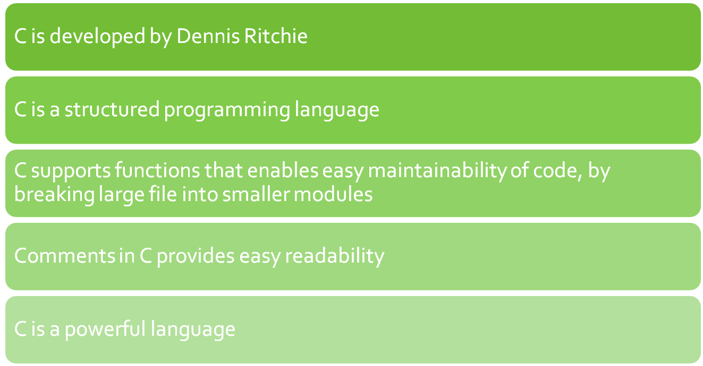
Overview of C

Slide 3

Program structure
A sample C Program
#include<stdio.h>
int main()
{
--other statements
// Comments after double slash
}

Slide 4
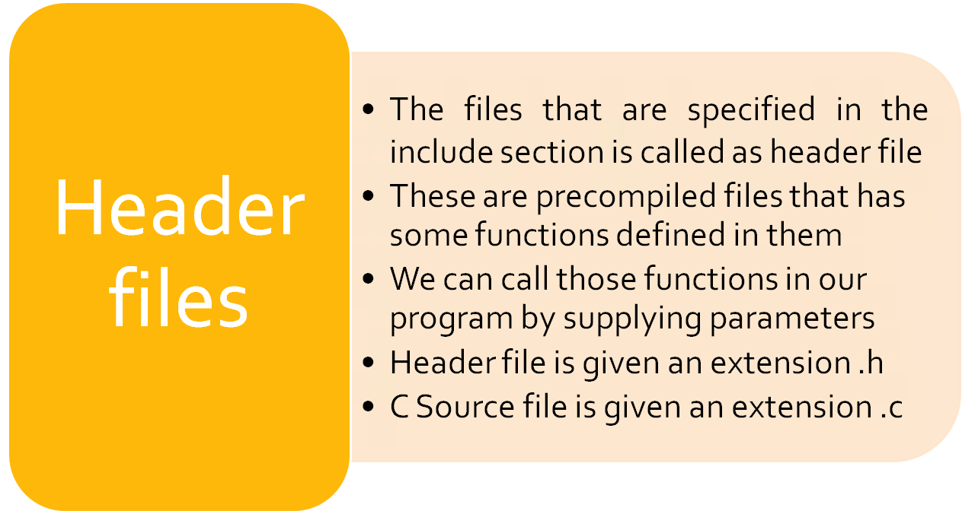

Slide 5
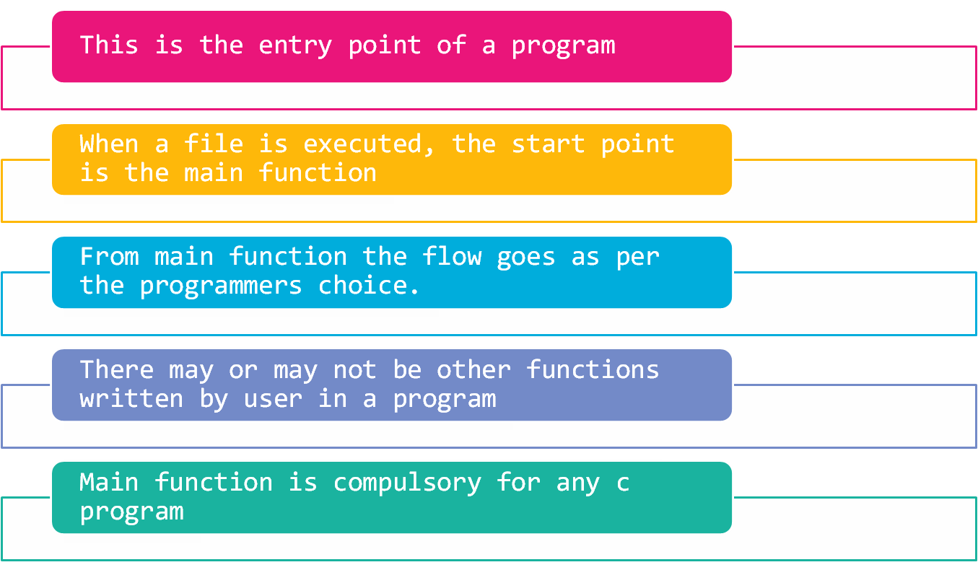
Main function

Slide 6

Writing the first program
#include<stdio.h>
int main()
{
printf(“Hello”);
return 0;
}
This program prints Hello on the screen when we execute it

Slide 7
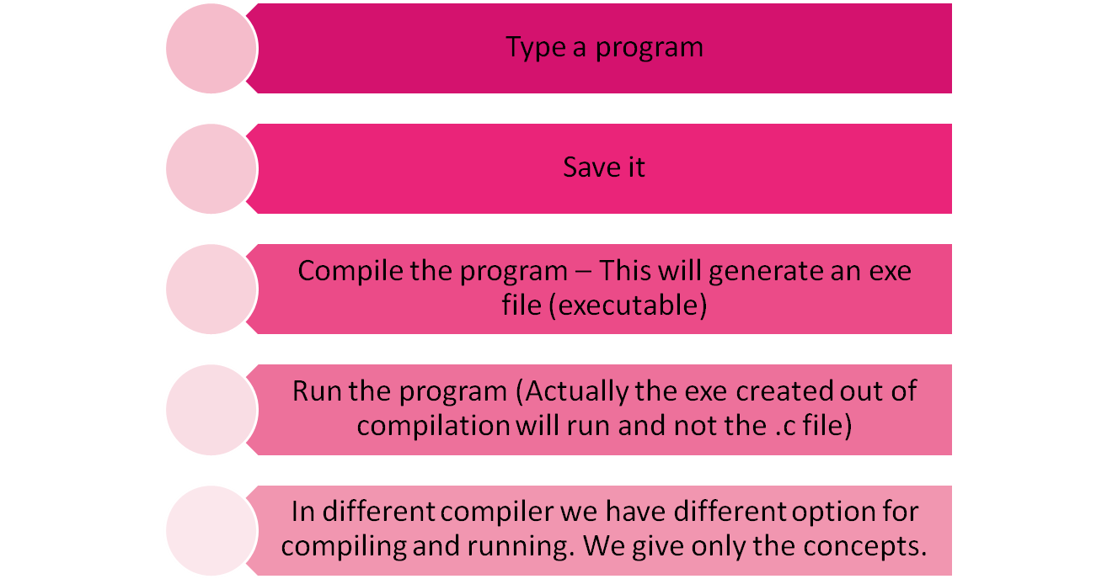
Running a C Program

Slide 8
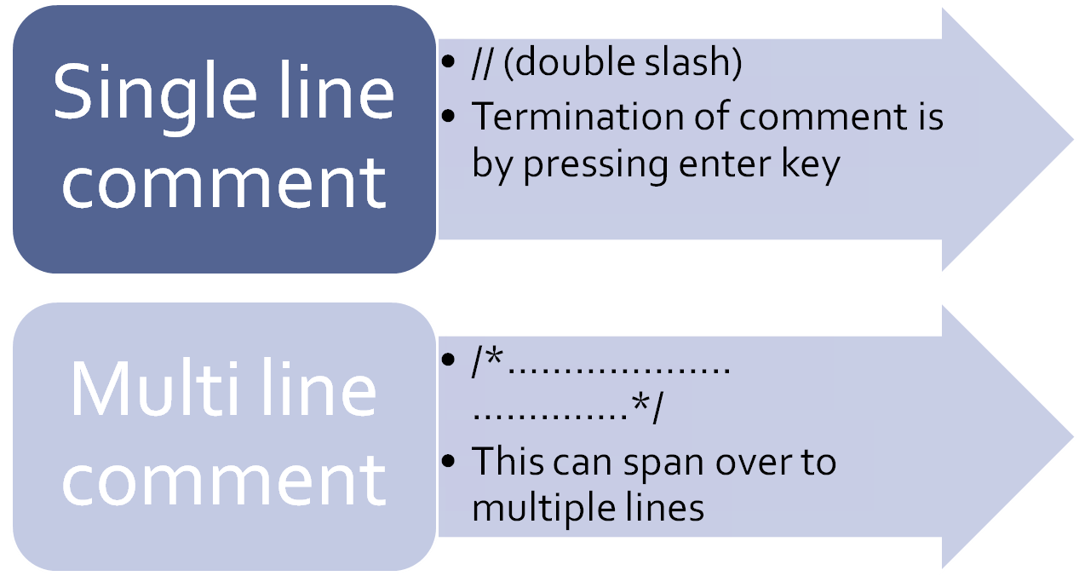
Comments in C

Slide 9
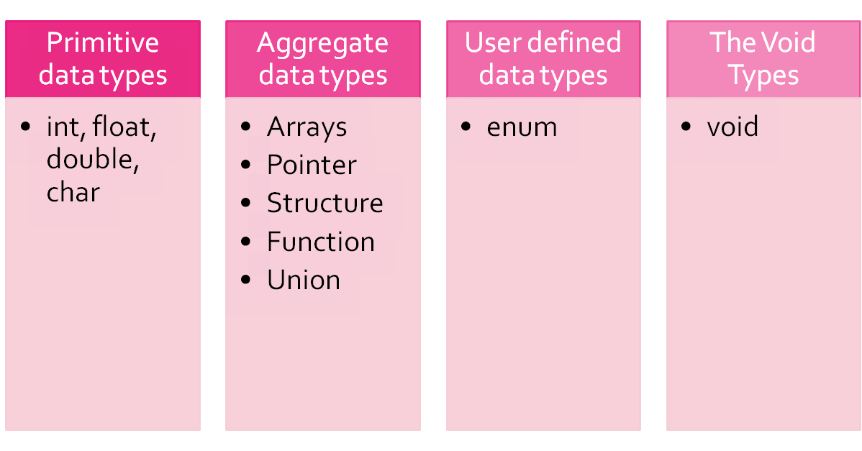
Data types in C

Slide 10
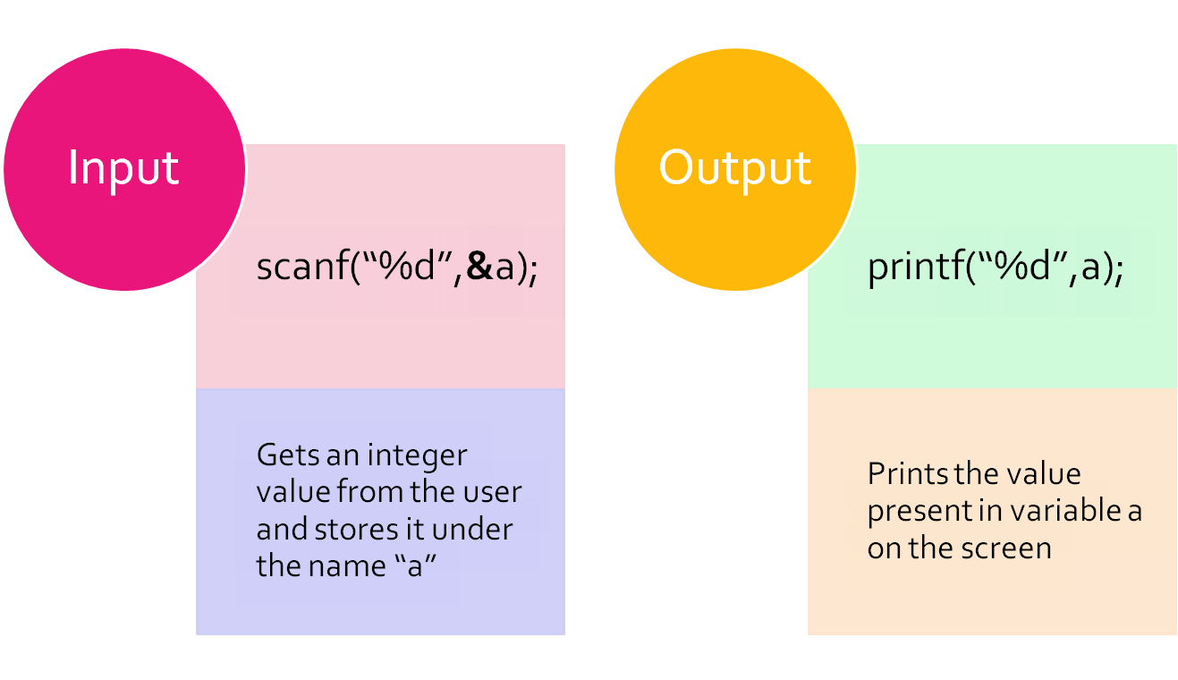
Input and Output
Notes:
Format specifiers
%d is the format specifier. This informs to the compiler that the incoming value is an integer value.
Other data types can be specified as follows:
%c – character
%f – float
%lf – double
%s – character array (string)
Printf and scanf are defined under the header file stdio.h

Slide 11

Conditional statements
if (condition)
{
stmt 1; //Executes if Condition is true
}
else
{
stmt 2; //Executes if condition is false
}

Slide 12

Conditional statement
switch(var)
{
case 1: //if var=1 this case executes
stmt;
break;
case 2: //if var=2 this case executes
stmt;
break;
default: //if var is something else this will execute
stmt;
}

